Slide 1
University of Basrah
Al-Zahraa Medical College
Ministry of higher Education and Scientific Research
Academic year 2021-2022
5th year
REPRODUCTIVE BLOCK
Duration : 1 hour
SUBFRTILITY
Presented by
Dr.RAYA MUSLIM AL HASSAN
Block staff:
Dr.Raya Muslim Al Hassan (Block leader)
Dr.Marwa Sadik (co leader)
Dr. Abdul kareem Hussain Subber
Dr.Alaa Hufdhi
GYNAECOLOGY 20th
EDITION by Ten Teachers

Slide 2
University of Basrah
Al-Zahraa Medical College
Ministry of higher Education and Scientific Research
Learning Objectives :
Define subfertility .
What are the causes of subfertility
How can manage a subfertile couple

Slide 3
What is subfertility?
University of Basrah
Al-Zahraa Medical College
Ministry of higher Education and Scientific Research
Subfertility is the failure of conception in
a couple having regular, unprotected coitus for 1 year
PRIMARY – Couple without a prior pregnancy
SECONDARY – Couple with previous pregnancy including miscarriage/ectopic
75-80% of couples will be pregnant after 12 cycles
90-95% of couples will be pregnant after 2-3 years.

Slide 4
University of Basrah
Al-Zahraa Medical College
Ministry of higher Education and Scientific Research
Causes :-
A - Female 30%
1- ovulatory disorders : -
The commonest cause is polycystic ovary syndrome (PCOS)
Hypothalamic disorders( e.g. Hypothalamic hypogonadism) .
Pituitary disease (e.g. Hyperprolactinaemia).
Endocrine abnormalities (thyroid disease) .
2- Tubal factors :- (PID, previous surgery, endometriosis)
3- Uterine factors :- (fibroid, adhesions)
4-Peritoneal (endometriosis).
5- Cervical factors .

Slide 5
University of Basrah
Al-Zahraa Medical College
Ministry of higher Education and Scientific Research
B -Male 30%
Compromised sperm number or quality is an important contributor to subfertility. ( Mainly unknown cause ) .
- Possible causes :-
Environmental and dietary issues.
Infections :- ( Orchitis , epididymitis )
Iatrogenic :- pelvic radiotherapy or surgery for undescended or torted testes .
Medical conditions such as diabetes .
Occupational factors :- contact with chemicals , radiation or heat .
Erectile difficulties or problems with ejaculation.
Genetic : aneuploidy of sex chromosomes (Klinefelter
XXY most commonly)
C - Mixed 15%
D -Unexplained 25%

Slide 6
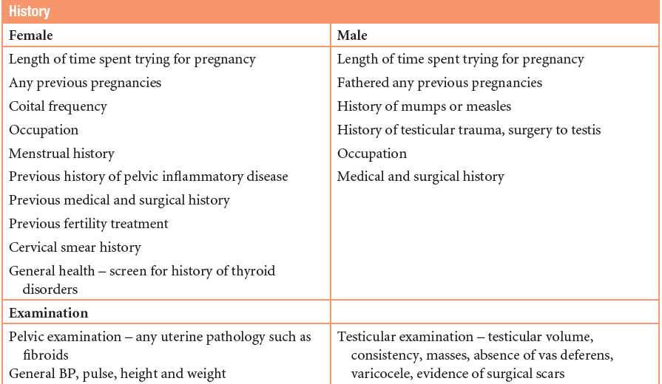
History & examination
University of Basrah
Al-Zahraa Medical College
Ministry of higher Education and Scientific Research

Slide 7
University of Basrah
Al-Zahraa Medical College
Ministry of higher Education and Scientific Research
INVESTIGATIONS
Female
Assess ovulation .
Tubal patency .
Uterine abnormality .
Male
Semen analysis .
Hormonal analysis(T, FSH, LH) +/-Karyotyping

Slide 8
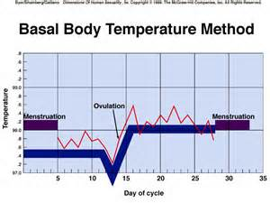
ASSESSING OVULATION
University of Basrah
Al-Zahraa Medical College
Ministry of higher Education and Scientific Research
1)History (regular cycle, dysmenorrhoea, breast engorgement)
2)Basal body temperature chart
3)Hormonal study
-Serum progesterone (mid luteal
phase ie day 21 of 28-days cycle)
- LH/FSH levels
-E2, Testosterone levels – PCOS
-Prolactin
-Thyroid tests
- Serum AMH????
•

Slide 9
University of Basrah
Al-Zahraa Medical College
Ministry of higher Education and Scientific Research
AMH is produced in the granulosa cells of ovarian follicles and does not change in response to gonadotrophins during the menstrual cycle. As a result, it can be measured and compared from any point in the cycle and, at present, is the most successful biochemical marker.

Slide 10
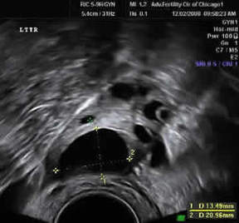
University of Basrah
Al-Zahraa Medical College
Ministry of higher Education and Scientific Research
4) Ultrasound
Assess ovulation
(by tracking the size of follicle)
U/S of the ovary at day 13 of cycle showing the pre- ovulatory dominant follicle size of 20 mm (normal 18-22 mm)

Slide 11
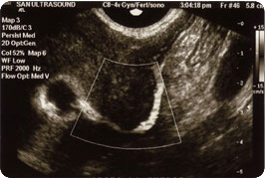
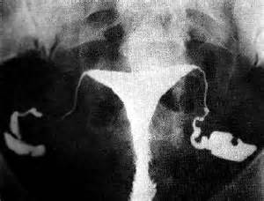
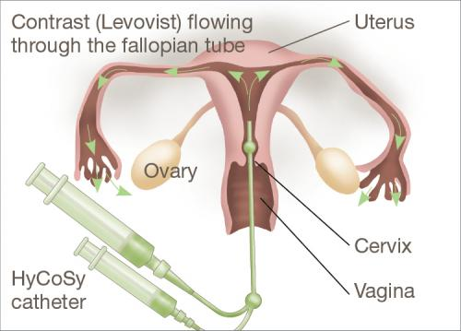
ASSESSING UTERINE/TUBAL PROBLEMS
University of Basrah
Al-Zahraa Medical College
Ministry of higher Education and Scientific Research
Hystero-Contrast -Sonography (HyCoSy)
HSG/hysterosalpingoigraphy

Slide 12
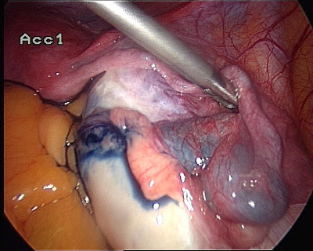
University of Basrah
Al-Zahraa Medical College
Ministry of higher Education and Scientific Research
Laparoscopy + dye test (chromotubation) if tubal blockage seen in HSG

Slide 13
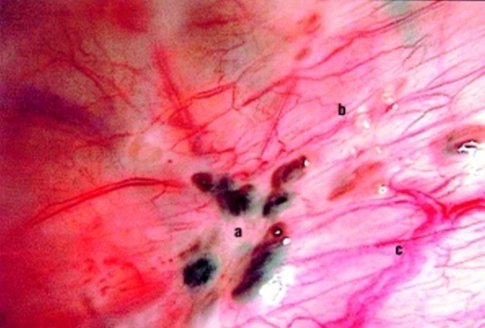
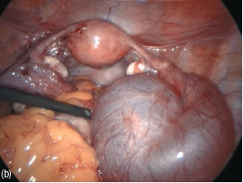
University of Basrah
Al-Zahraa Medical College
Ministry of higher Education and Scientific Research
ASSESSING PERITONEAL FACTORS
Laparoscopy
endometriosis

Slide 14
INVESTIGATIONS (MALE)
University of Basrah
Al-Zahraa Medical College
Ministry of higher Education and Scientific Research
Semen analysis
Needs prior appointment with lab
Abstinence 2-4 days.
Complete collection of the semen
Transport to lab in 1 hour
Put it in incubator 37˚c or at room temperature.

Slide 15
University of Basrah
Al-Zahraa Medical College
Ministry of higher Education and Scientific Research

Slide 16
TREATMENT
University of Basrah
Al-Zahraa Medical College
Ministry of higher Education and Scientific Research
Fertility treatment should be individualized to optimize the treatment result, Management may be expectant, medical, surgical or combination of these.

Slide 17
OVULATION INDUCTION
University of Basrah
Al-Zahraa Medical College
Ministry of higher Education and Scientific Research
1) Normogonadotrophic anovulation (PCOS).
Anti- oestrogens e.g Clomiphene/ Tamoxifen
Metformin
Gonadotrophins
2) Hypogonadotrophic hypogonadism
Pulsatile GnRH
Gonadotrophins with LH activity
Bromocriptine ( for hyperprolactinaemia)
3) Laparoscopic ovarian drilling
4) Luteal phase support-progesterone

Slide 18
Peritoneal/Uterine/tubal problems
University of Basrah
Al-Zahraa Medical College
Ministry of higher Education and Scientific Research
Endometriosis:Laparoscopic surgical ablation/ resection of spots + adhesiolysis .
Uterine factors: hysteroscopic adhesiolysis for Asherman’s syndrome ,myomectomy for fibroid .
Tubal factors: Laparoscopic tubal surgery or IVF .

Slide 19
Treatment of male subfertlity
University of Basrah
Al-Zahraa Medical College
Ministry of higher Education and Scientific Research
According to the cause
IUI ???
IVF ???

Slide 20
University of Basrah
Al-Zahraa Medical College
Ministry of higher Education and Scientific Research
Intra-uterine insemination(IUI): injection of activated semen inside the uterus by a catheter

Slide 21
University of Basrah
Al-Zahraa Medical College
Ministry of higher Education and Scientific Research
IVF

